Slide 1
EMS Presentation #1/9
Dr. Nichole Feeney; February 23, 2023

Slide 2
Case #1/7
Date: 11/20/2022
Address: 44 W Bonanza Pl
Crew:
Greg Mares
Luke Cahalan
Call: 88-year-old male vomiting up blood.

Slide 3
EMS Assessment
Medications: Simvastatin, warfarin, ranitidine, lisinopril, levothyroxine, and omeprazole
NKDA
Vitals:
HR 70, BP 140/90, RR 18, O2 90%, BG 154, Temp 36.6
Interventions: IV Zofran, Oxygen 4L NC, IV Zofran
Summary: The patient’s daughter called 911. He has been sick since yesterday. Vomit has had blood in it. He could not say how much. He is bloated. No abdominal pain. He is taking his medications. No drug use or alcohol. No chest pain, shortness of breath, dizziness, LOC, poisoning, etc.
He was found sitting in a chair in his bedroom. Vomit was on the floor. He is alert and oriented x 4. Exam was normal.

Slide 4
ER Evaluation
Felt to be in congestive heart failure
Possible Mallory Weiss tear
Complete blood count normal
BNP elevated in 300s
INR normal at 2.9
Troponin normal, EKG no acute changes
Admitted

Slide 5
Gastrointestinal bleed and anticoagulation

Slide 6
Coumadin vs Xarelto

Slide 7
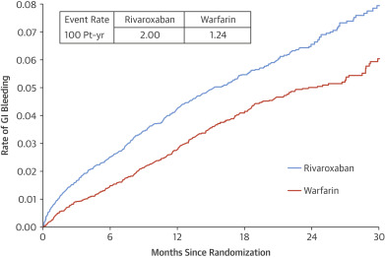
Coumadin vs Xarelto

Slide 8
Reversal agents
Coumadin: Vitamin K, Kcentra, FFP
Xarelto: Andexxa, platelets, FFP, Kcentra
Eliquis: Andexxa, platelets, FFP, Kcentra
Pradaxa: Idarucizumab, Factor VIIa, Kcentra
Aspirin/dipyridamole, Plavix, Brillinta, Effient: Consider ddAVP

Slide 9
Rest of the story….
Discharged home 24 hours later on Bumex and potassium
Back in the ER 12/29 for hypoxemia
Chest x-ray with atelectasis vs pneumonia. Lasix and azithromycin ordered.
1/29/23 back in the ER with partial small bowel obstruction

Slide 10
Case #2/7
Date: 2/2/2023
Address: 6 Saint John Cr
Crew:
Daniel Steinweg
Call: 61 year old male with difficulty breathing

Slide 11
EMS Assessment
Vitals:
BP 192/118, HR 103, RR 22, O2 79%, Co2 35, GCS 15
Summary: Dispatched to a 61 yo male having trouble breathing. Met patient outside on the sidewalk. He reported he was having a hard time breathing and was noted to be having a hard time talking. He had been feeling this way for the last three months. He was worse in the last 24 hours. He had seen his primary for labs and testing. He has oxygen at home but “doesn’t need it”. He denied any chest pain, LOC, neck or back pain.
Exam: mild respiratory distress. Oriented. Breath sounds were clear. Skin warm and pink. Oxygen applied at 4L NC and he was 97%.

Slide 12
ER Evaluation
Complex 61 yo male who presented with 1 month of not feeling well. Told he should be using oxygen by his doctor. Orthopnea. Progressive edema. In November 2022, he had multiple hospitalizations for necrotizing pancreatitis with peritoneal abscess, pleural effusions, and thoracentesis.
Recent echo with EF 50%, mild mitral regurgitation, trace pericardial effusion
More relief with NTG than Duoneb in ER
Mildly elevated BNP
CT with moderate to large pleural effusion on left and small on right
Admitted for diuresis and thoracentesis. Did well and discharged home.

Slide 13
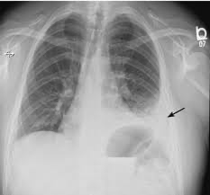
Pleural Effusion

Slide 14
Pleural effusion
Symptoms: Cough, sharp chest pain, or shortness of breath
Causes: Infection, tumor, injury, heart failure, liver failure, connective tissue disorder, pulmonary emboli
Treatment:
Drain fluid
Antibiotics
Diuretics

Slide 15
EMS Case #3/7
Date: 1/27/2023
Address: 83 E 170
Crew:
Charisse Sweetnam
Caleb Voorhees
Call: Rav 4 hit a deer. Patient has a leg injury.

Slide 16
EMS Assessment
NKDA
Vitals:
HR 76, BP 193/103, O2 97%, BG 145, RR 18, GCS 15
Summary: Patient was the driver of a black Rav4 that hit a deer running across the freeway. He not see the deer before he hit it. He was driving about 75 mph with the cruise control on. He was wearing his seatbelt. Front and side airbags did deploy. He has left shin abrasion and bruising. No other injuries, head injury, loc. No chest pain or sob. Extensive front end damage noted at the scene. No intrusion into the vehicle.
Exam: No distress. Fully oriented. Clear lungs and heart. Spine is normal. No visible fractures or deformities. Abrasion on left shin.

Slide 17
ER Evaluation
Evaluation unremarkable
X-rays normal

Slide 18
Wildlife collisions
Most common at dawn and dusk
Most high risk area in this region is Hwy 82 between Glenwood and Aspen
Account for 4-10% of all accidents nation wide
26,000 injuries estimated
And 150 – 200 deaths annually

Slide 19
Wildlife Collision facts
Virginia has the most
Most common animal hit is the deer
More than 10,000 dogs are hit each year
Approximately 6% of people swerve to avoid hitting animals

Slide 20
Wildlife Collisions in Colorado
3,960 wildlife collisions in 2014
287 human injuries
6 fatalities
90% of wildlife accidents happen on 2 lane roads
84% on dry roads and in clear weather
Majority of accidents happen in the fall

Slide 21
EMS Case #4/7
Date: 1/29/2023
Address: 124 Stone Quarry Rd
Crew:
Jacob Oldright
Joseff Diedrich
Christopher Davidson
Marco Rojas- Vargas
Call: 65 yo male with sensation of heart palpitations

Slide 22
EMS Assessment
PMH: Atrial fibrillation
Medications: Metoprolol, Amiodarone, Xarelto
All: PCN
Vitals:
BP 135/97, HR 86, RR 18, 97%
Summary: He was diagnosed with atrial fibrillation approximately 2 weeks prior and was trying to get better about monitoring it. He reports something simply “does not feel right”. He denies any chest pain, shortness of breath, wheezing, or N/V. He was placed on amiodarone recently.
Exam: He was found standing at front doors of fire station 31. Alert and oriented. Normal respiratory effort. Afib noted on monitor. Patient refused transport.

Slide 23
ER Evaluation
Cardiovascular notes
Known congestive heart failure
Mitral regurgitation
Atrial fibrillation
Known since 2019

Slide 24
Atrial fibrillation facts
AFib is the most common type of irregular heart rhythm (also called arrhythmia). It affects an estimated 2.7 to 6.1 million people in the U.S. at any given time, and causes about 450,000 hospitalizations each year.
AFib can affect people of any age, including children, though it mostly occurs in people over 60. As the population grows older, the number of cases is expected to rise; experts estimate there will be 12.1 million cases in the U.S. by 2030.

Slide 25
Atrial fibrillation treatments
Rate control/ blood thinners
Cardioversion
Ablation
Watchman procedure

Slide 26
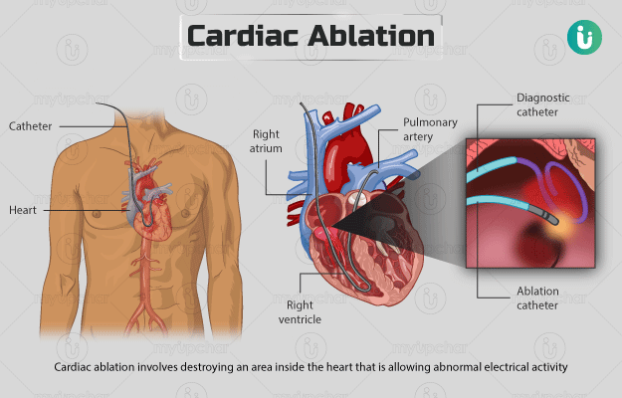
Ablation

Slide 27
Watchman procedure

Slide 28
EMS Case #5/7
Date: 2/3/2023
Address: 90 Logans Ln
Crew:
Call: Dispatched to 67 yo male with abdominal pain.

Slide 29
EMS Assessment
Medications: Lisinopril, atorvastatin
Allergy: Codeine
Summary: Patient states he has lower abdominal pain that radiates between his right and lower abdominal quadrants. Pain is 10/10. He has been lifting heavy objects in the last few days. He didn’t have the pain then. He came home from work to rest and he laid down flat which made his pain worse. He drank water and this made him vomit. Not radiating. No alcohol, drug use, constipation, chest pain, shortness of breath, lightheadedness, dizziness.
Exam: He was sitting up on his couch. In pain but not distress. He is alert and oriented. Breathing is regular. He complained of pain with palpation in RLQ and LLQ.

Slide 30
ER Evaluation
Patient noted to drink a few beers per day
Localizes on exam to RLQ and LLQ
CT with large left inguinal hernia causing obstruction
He was taken to surgery for repair the next day
Doing well on follow up

Slide 31
GI Emergencies
1. GI bleeding
01
2. Peritonitis
02
3. Acute mesenteric ischemia
03
4. Bowel obstruction
04
5. Pancreatitis
05

Slide 32
Bowel obstruction
Small and large bowel obstructions account for 15% of hospital admissions with acute abdominal pain
20% of those need acute surgical care
Important cause of morbidity and mortality with nearly 30,000 deaths per year

Slide 33
Bowel obstruction

Slide 34
EMS Case #6/7
Date: 2/7/2023
Address: 222 Smokey Hill Cr
Crew:
Nathan Voorhees
Cody Reese
Call: 7 yo male with difficulty breathing

Slide 35
EMS Assessment
Vitals: BP 118/70, HR 134, RR 22, 98%
Summary: Discharged for 7 yo with difficulty breathing. Woke up at night having trouble. Mother gave him his brother’s breathing treatment. He states that it hurts to cough.
Exam: He is alert and oriented. Audible inhalation and exhalation wheezes noted. Airway is intact.
Second nebulizer treatment given with improvement.

Slide 36
ER Evaluation
Diagnosed with croup clinically
Treated with oral dexamethasone
COVID negative

Slide 37
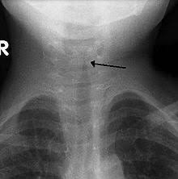
Croup
Swelling of windpipe and voice box
Usually viral
Most common in children ages 6 months to 3 years
Most get better in 3-4 days

Slide 38
Differential to keep in mind…
Epiglottis
Ludwig’s angina
COVID
Foreign body aspiration
Vocal cord dysfunction
Tracheomalacia

Slide 39
EMS Case #7/7
Date: 2/9/2023
Address: 149 Sagemount Cir
Crew:
Veronica Cahalan
Ben Crow
Call: Patient has been sick for a long time and vomiting blood.

Slide 40
EMS Assessment
Vitals: BP 187/95, HR 75, RR 16, O2 98%, GCS 15
Summary: 68 yo female sick for a long time. She ha been vomiting blood. Abdominal pain 9/10. No history of ulcers, GI bleed, bowel obstruction, or abdominal surgeries. She is a recovering alcoholic and drank a little bit last night. She also ate food that she believes could be causing the issue. She had breakfast. She only has one kidney from a previous accident. No recent trauma. She did try to take Zofran without relief.
Exam: Patient heard yelling for help on arrival. Alert and oriented. Ambulated to living room. Tachypnea. Abdominal guarding. Mild retching. Vomit yellow with no blood. Restless. Anxious.
Interventions: Normal saline, Zofran, EKG

Slide 41
ER Evaluation
Registered in ER under wrong name
IVF, Toradol, Reglan, Phenergan
WBC mildly elevated
Diagnosed with gastroenteritis likely viral and discharged home

Slide 42
Norovirus
Between Aug. 1, 2022, and Jan. 8, 2023, there were 225 norovirus outbreaks among the 14 states that participate in the CDC’s NoroSTAT reporting program
A significant increase over the same time period between Aug. and Jan. 2022, when there were only a reported 172 outbreaks.
19.4% positivity rate in Midwest
West is still rising and has not peaked as of 2/4/2023 at 13%+
The CDC generally records roughly 2,500 outbreaks of norovirus each year, with around 19 to 21 million thought to be infected annually.
Of those, approximately 110,000 will be hospitalized, and around 900 die, on average.

Slide 43
Norovirus

Slide 44
EMS Case #8/7 (☺)
Date: 2/11/2023
Address: 854 W Battlement Pkwy
Crew:
Crystal peters
Gregorio Mares
Call: Call for sick person

Slide 45
EMS Assessment
Vitals: BP 118/64, HR 110, RR 16, BG 107
Summary: Call for 25 yo sick female. She is complaining of dehydration. She has been sick for a few weeks now and felt worse today. She has not been able to drink fluids for 24 hours. It has been a few days since she last ate food. No medical or surgical history. Not pregnant. No medications. No allergies.
Exam: Found laying down on her couch. No distress. Oriented.

Slide 46
ER Evaluation
Three weeks of URI symptoms
1
1 day of ear pain
2
CBC and CMP normal except for dehydration
3
COVID negative
4
Strep positive
5

Slide 47
Atypical strep presentations
Classic is fever, sore throat and lymphadenopathy
Abdominal pain
In kids as much as 10% of new onset abdominal pain and fevers = strep
Nausea and vomiting
Rash

Slide 48
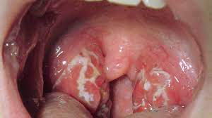
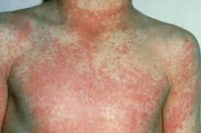
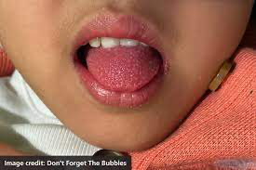
Strep

Slide 49
PANDAS

Slide 50
PANDAS

Slide 51
PANDAs

