Slide 2
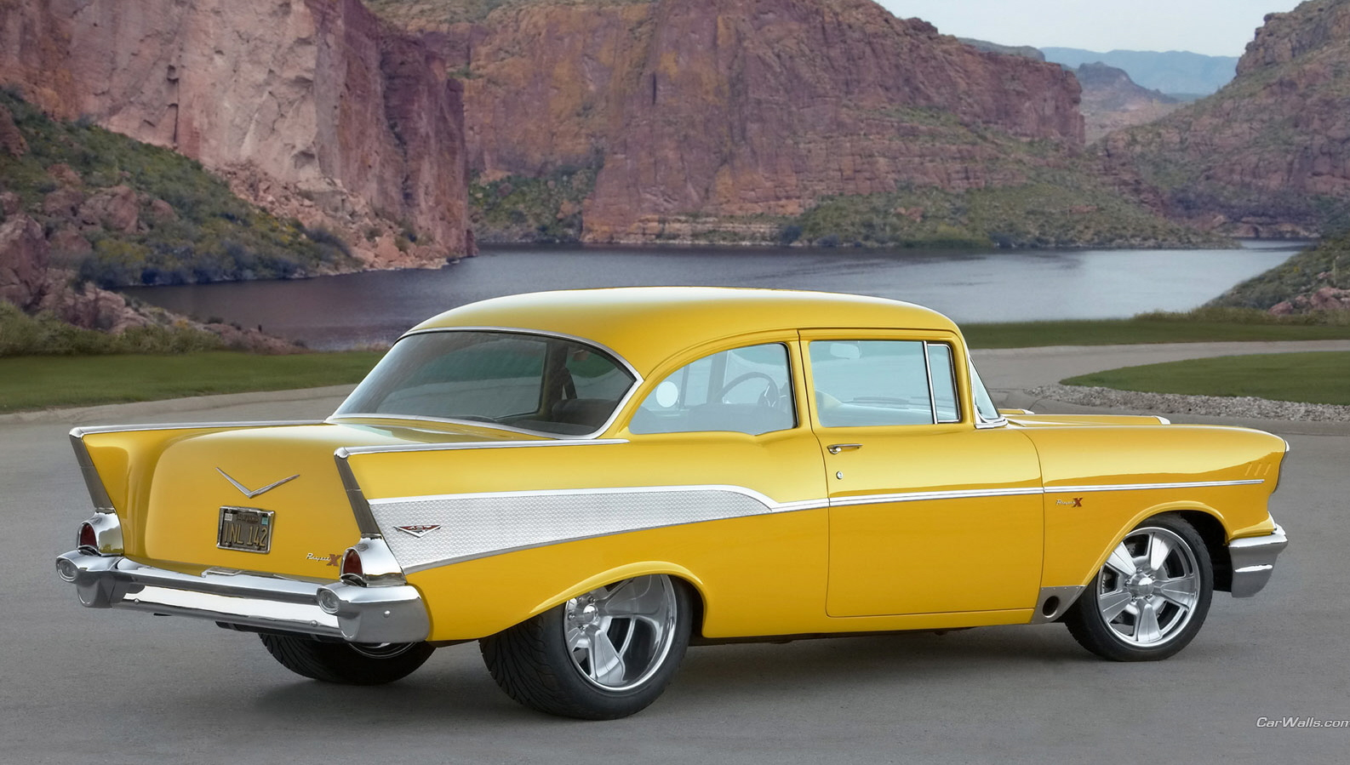
The Classic Car!

Slide 3
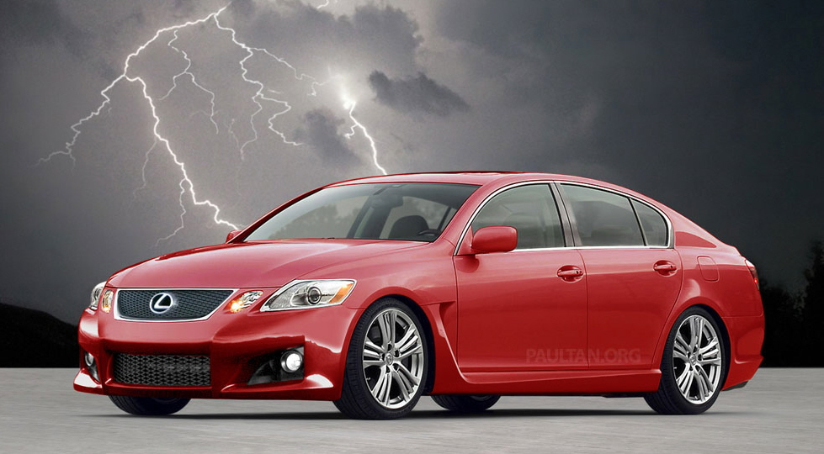
Today’s Car

Slide 4
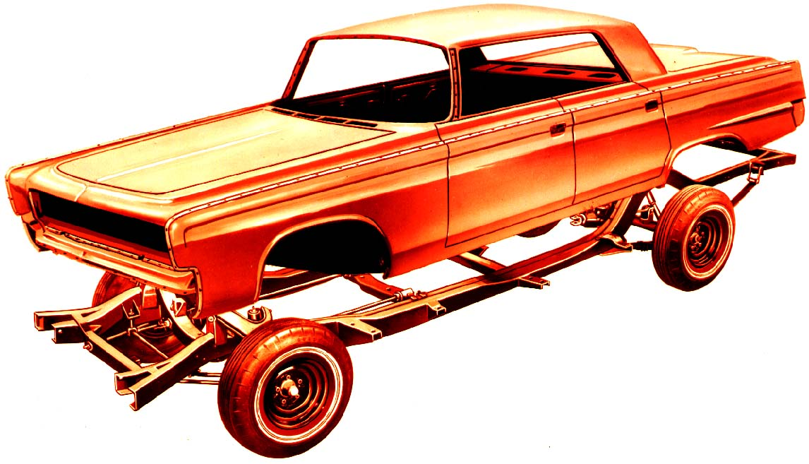
Full Frame Construction
Commonly found on older model vehicles, pick-up trucks, sport utility vehicles and full size vans

Slide 5
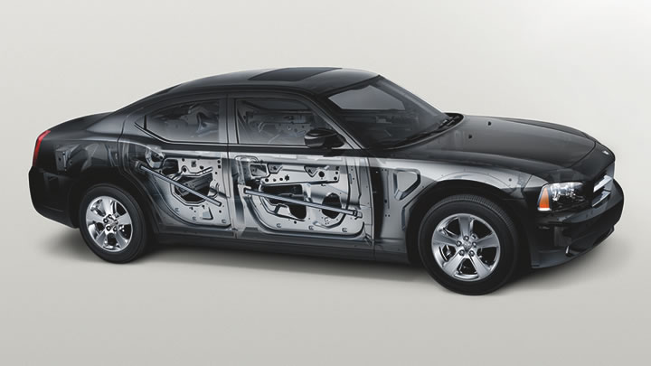
Unibody Construction
A manufacturing process where sheet metal body parts are combined with stress-bearing elements to form the body and chassis as a single piece, as opposed to attaching body parts to a frame

Slide 6
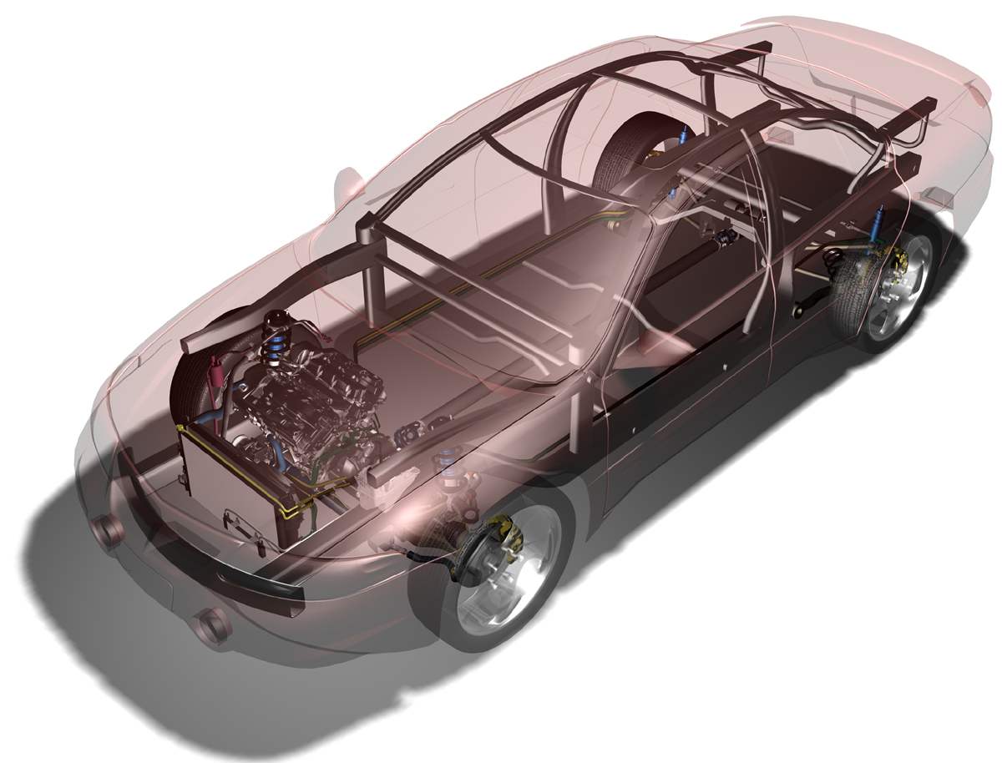
Space Frame Design
The spaceframe of a vehicle is a load bearing structural frame which supports a vehicles powertrain components and bodypanels.

Slide 7
High Strength Steels
Mild Steel
  ◆ Application- fenders, floor pans, quarter panels, rocker panels
HSS - High Strength Steel
  ◆ Application- hoods, door skins, quarter panels
HSLA - High Strength Low Alloy
  ◆ Application- Pillars, side members, front upper and lower rails, front strut tower, crumple beam

Slide 8
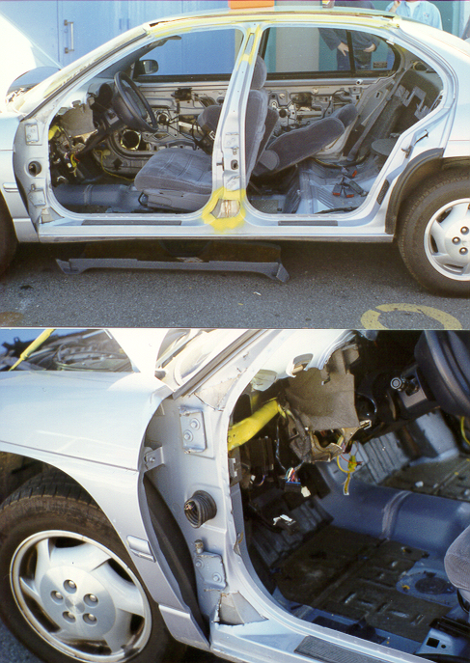
High Strength - Low Alloy Steel

Slide 9
More Steel Option
Addition of layers of strong HSLA steel to increase integrity of vehicle.
First attempt by manufactures to beef up cars.
  Subaru
  Toyota
  Honda

Slide 10
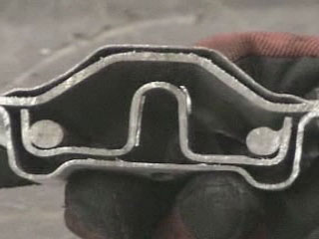
2005 Subaru WRX “B” Post

Slide 11
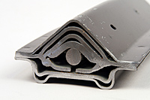
2010 Subaru Legacy
B-Post*
Notes:
The new design of many of the Posts on new vehicles will not allow most hydraulic tools to cut through them. They are also made from materials that can not be cut with a reciprocating saw.
11

Slide 12
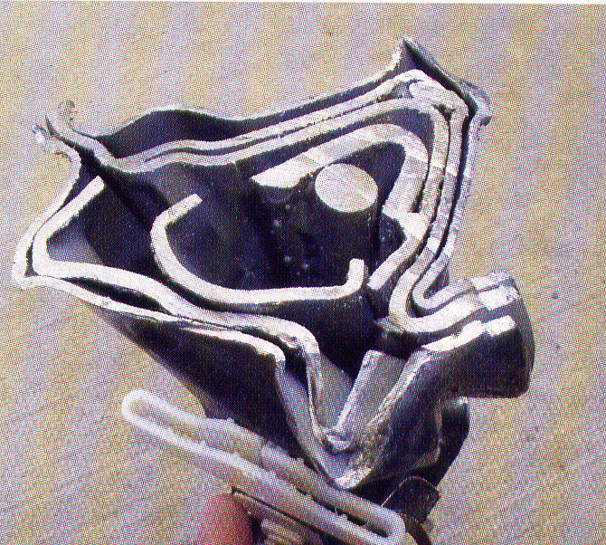
2005 Subaru B – Post

Slide 13
High Strength Steels, cont’d.
UHSS - Ultra High Strength Steel(120,000 lbs min tensile)
  ◆ Side door beams, Pillars, Reinforcement bars under dash, bumper reinforcement
  ◆ Major Load Bearing areas
  ◆ Boron Steel

Slide 14
Less Steel Option
Removal of layers of mild and HSS and replaced with Ultra High Strength Steel.
Very popular option currently.
Strongest
  Volvo
  Mercedes
  Ford
  Volkswagen
  BMW
  Jeep
  Many More

Slide 15
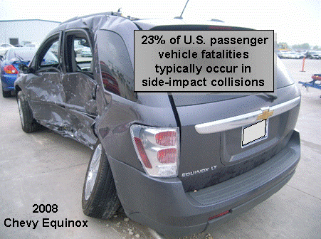

Slide 16
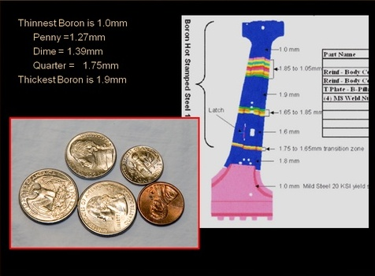

Slide 17
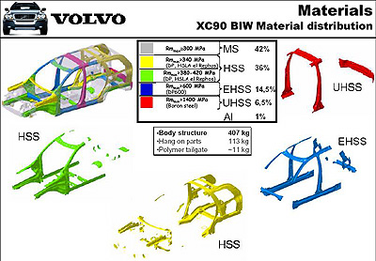

Slide 18
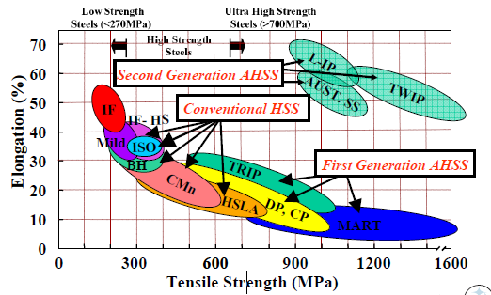
VEHICLE CONSTRUCTION
1 Mpa = 145 psi 1600 Mpa = 232,000 psi
Notes:
This chart shows the evolution of steel strengths used in vehicle construction. For many years steels had a tensile strength around 300MPa (43,500 psi). Cutting tools with 40,000 to 50,000 lbs of cutting force had no trouble with these steels.
As we moved into high strength steels, the amount of force required to cut these steels doubled. At the start of new Millennium, many vehicle makers started using Advanced High Strength or Ultra High Strength steels. The amount force required to cut or fracture these materials is in excess of 200,000 lbs.
18

Slide 19
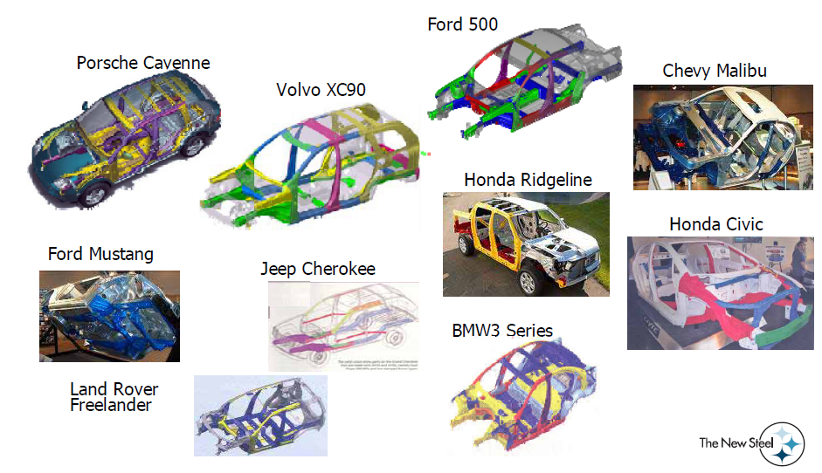
VEHICLE DESIGN
Notes:
Every part of the vehicle is designed to do a specific task. Each part is made from a specific alloy material with a specific thickness. It is impossible to determine the type of material or the hardness of the material by just looking at it.
For this reason, we must have a Plan B, C and D available and be ready to change plans as soon as we realize our original plan is not working.
19

Slide 20
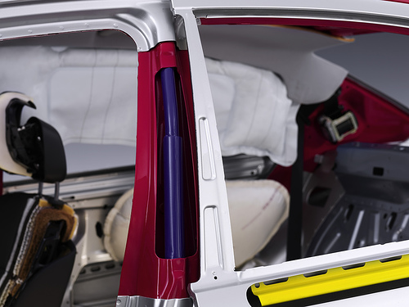
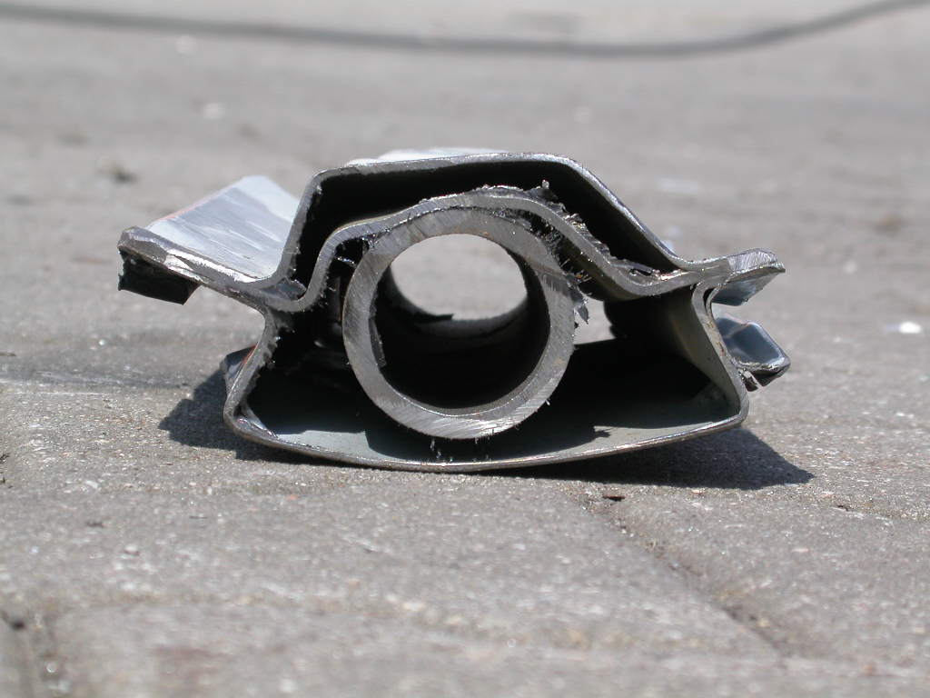
Mercedes C Class

Slide 21
History of Vehicle Safety Systems
1947 First seat belts (lap belts) were offered in the American made “Tucker”.
1967 Front seat belts became mandatory.
1968 Shoulder belts became mandatory.
1972 Airbags available in some vehicles.
1991 Driver airbags are made mandatory.
1991 FED pushes side impact protection (SIP).
2004 Vehicles have up to 16 separate airbags and
16 pyrotechnic charges.
Notes:
21

Slide 22
Seat Belt Pretensioners
Designed to tighten or back wind seat belt
Can be electrical or mechanical
  ◆ Electrical pretensioners deploy with front airbags
  ◆ A pyrotechnic device with a small gas generator
Models that back wind the seat belt are located anywhere in the B, C, D pillars.

Slide 23
Seat Belt Pretensioners, cont’d.
Models that use a cable to tighten the seat belt can be located on the buckle side or pillars side.
Solution: Cut seat belt early in the extrication and avoid cutting into loaded pretensioning devices. This will prevent sitting your patient upright in their seat.

Slide 24
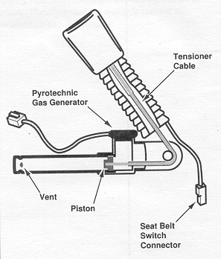
Seat Belt Pretensioners
(Courtesy of General Motors)

Slide 25
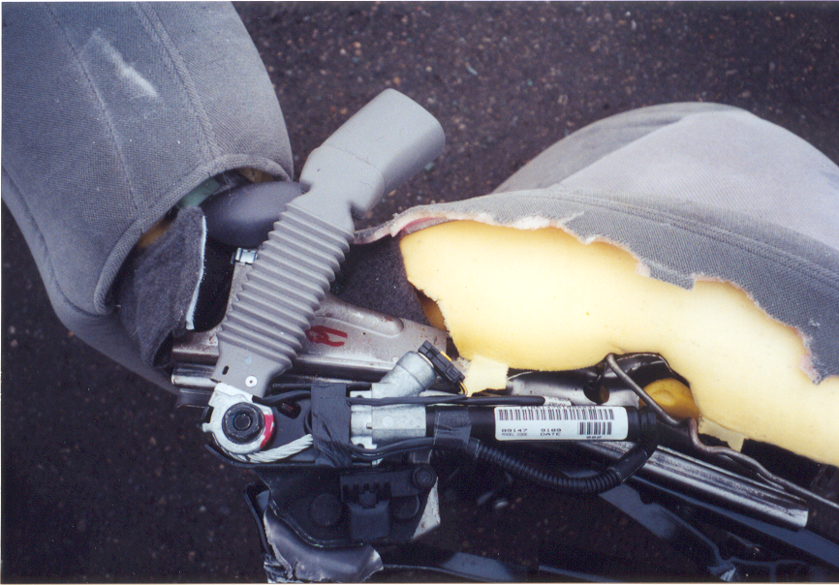

Slide 27
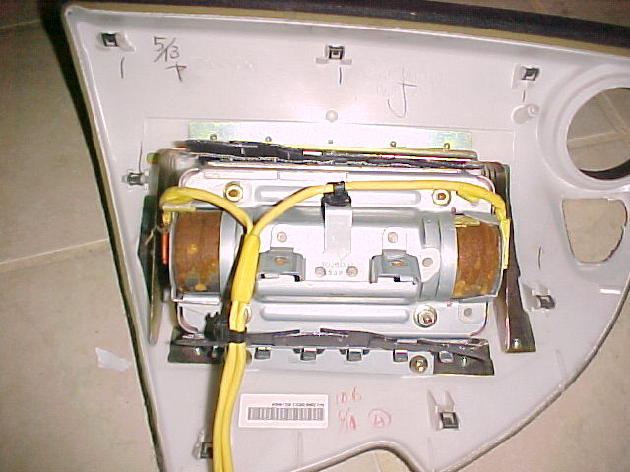
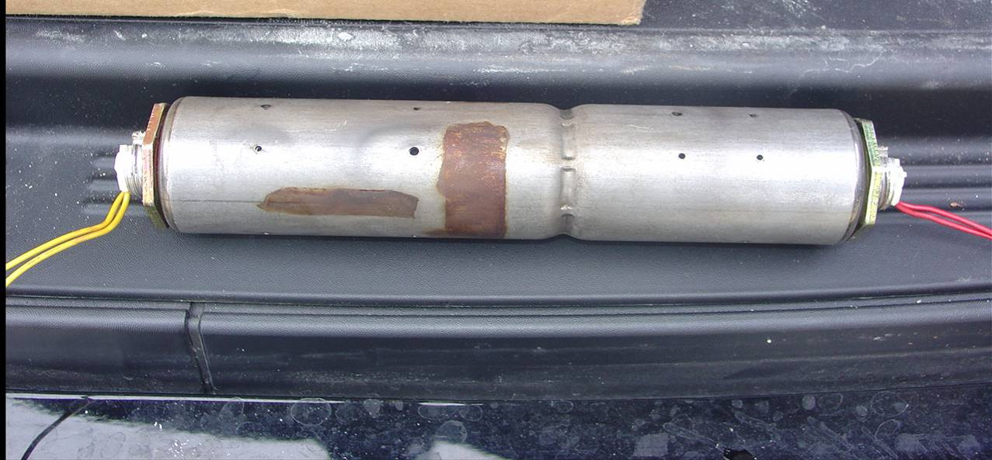
Supplemental Restraint Systems
Double-deployment or Dual-Action Airbags
Smart Airbags & Advanced Airbag Systems
Federal Motor Safety Standard 208
  100% of cars equipped with Smart Airbags by 2007
Notes:
Secondary impacts and different speed deployment. Testing showed 2 minute second deploy after initial deploy

Slide 28
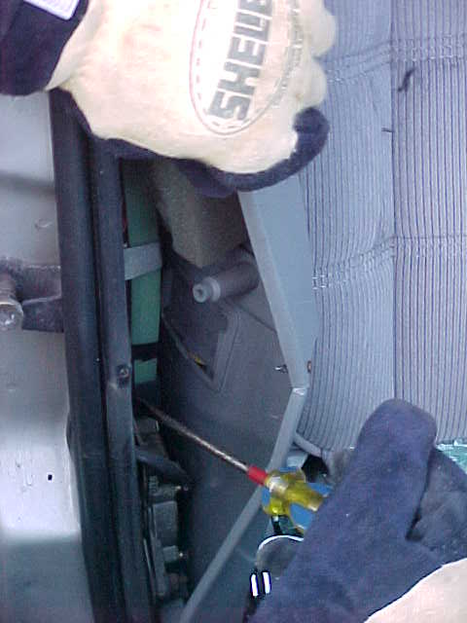
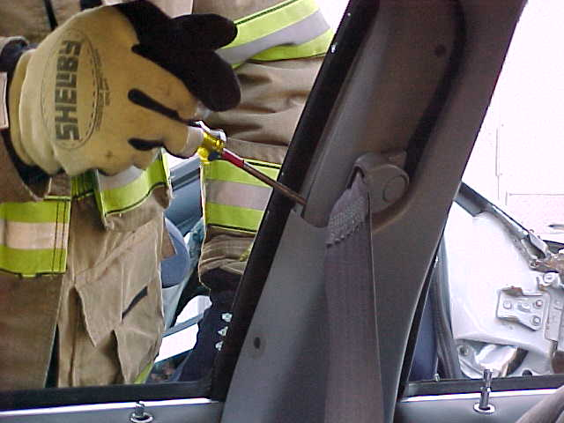
Peel and Peek

Slide 29
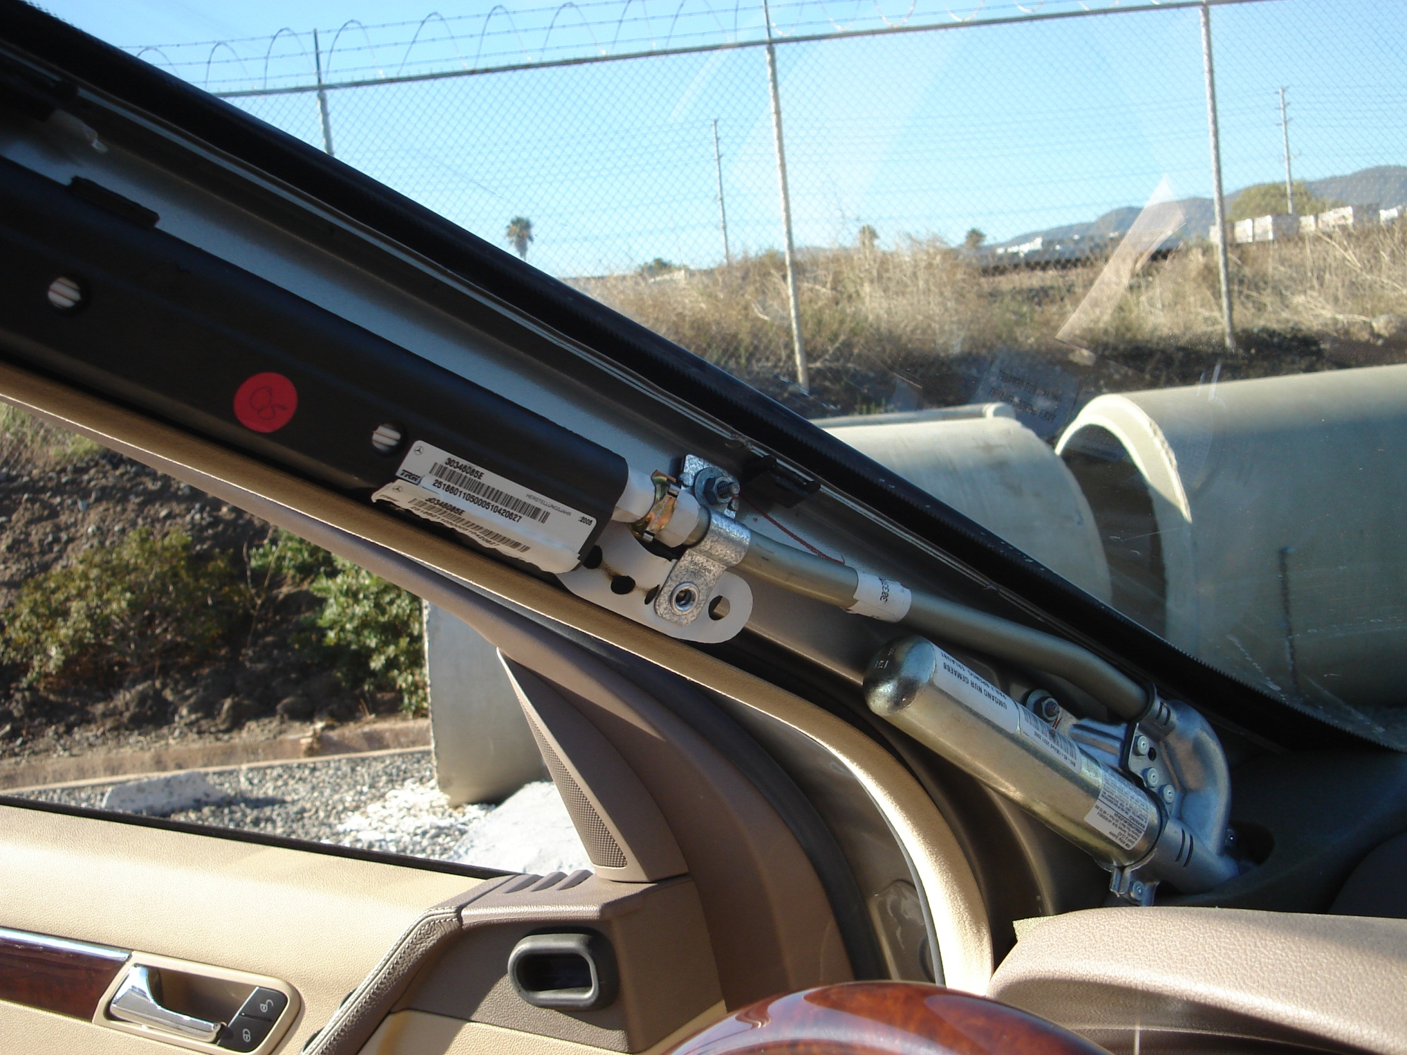
A-post cylinder

Slide 30
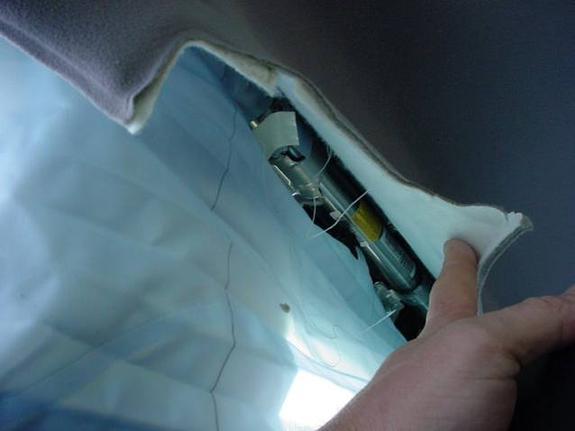
Cylinder Above “B” Pillar
Above B-post cylinder

Slide 31
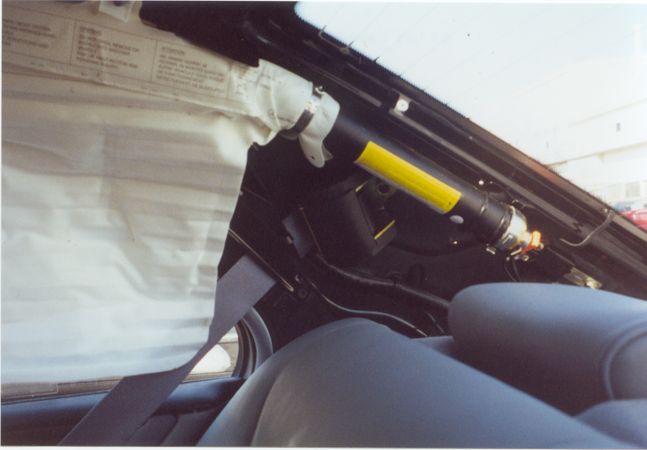
C-post cylinder

Slide 32
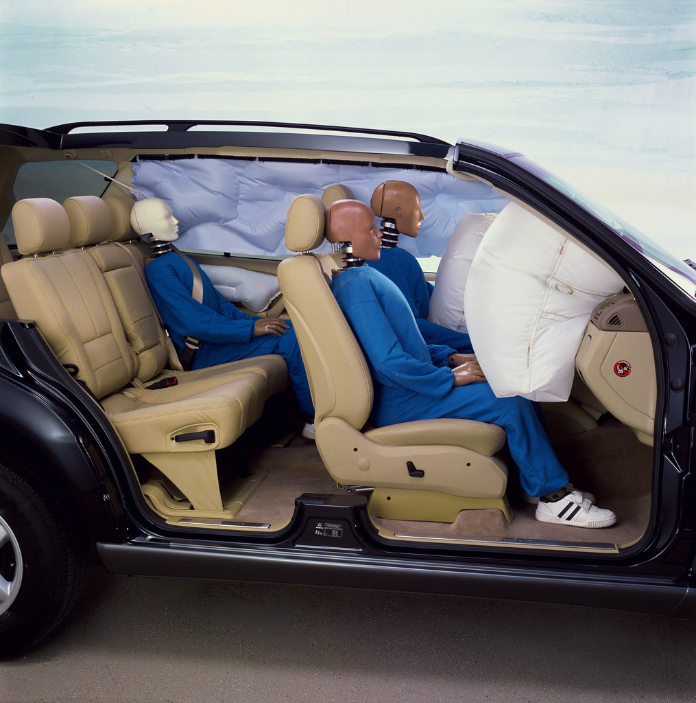
Airbag Deployment Zones
5”
10”
20”

Slide 33
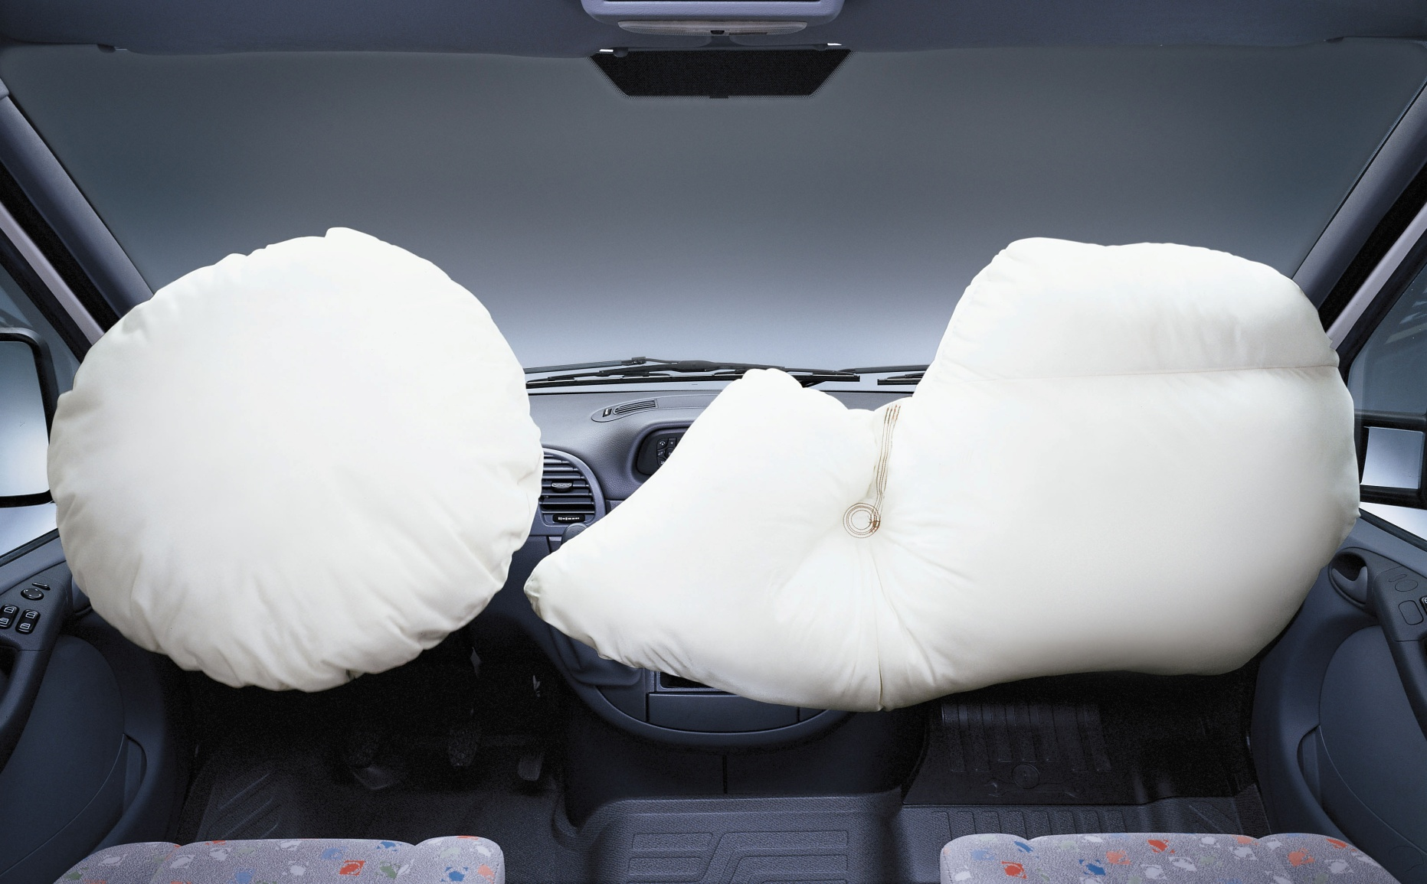
New Airbag Ideas
FRONTAL AIRBAGS *
Notes:
Most newer vehicles have bucket seats with a center console. This leaves an opening for an unrestrained rear seat occupant to pass through the front seats and strike the dash head first in a frontal collision.
In an attempt to protect the unrestrained rear seat occupant the automakers are changing the shape and design of the passengers front airbag.
www.sceneoftheaccident.org
33

Slide 34
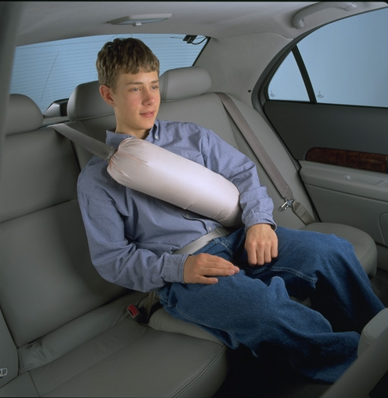
Airbags, cont’d.
ITTR (Inflatable Tubular Torso Restraint)
Rear Seats Only

Slide 35
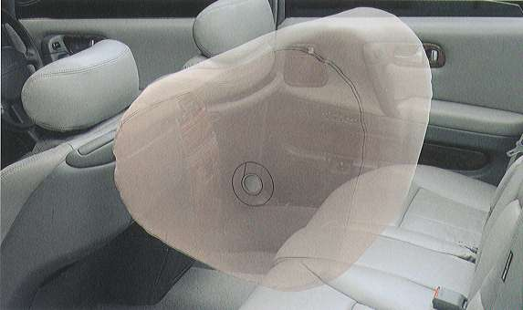
Nissan President
Rear Seat Airbag

Slide 36
Battery Locations
Under hood
Trunk – Floor, sidewalls
Wheel wells – Chrysler Cirrus, Concorde, 300M
Under rear seats – Buick LaSabre, Lucerne, Riviera
Under passenger seats – Mercedes M-class, R-class
Under drivers seats – Audi Q7
Front passenger floorboard – Mercedes B-class
Rear passenger floorboard – Buick Enclave
Both under hood and in the trunk – Mercedes CL

Slide 37
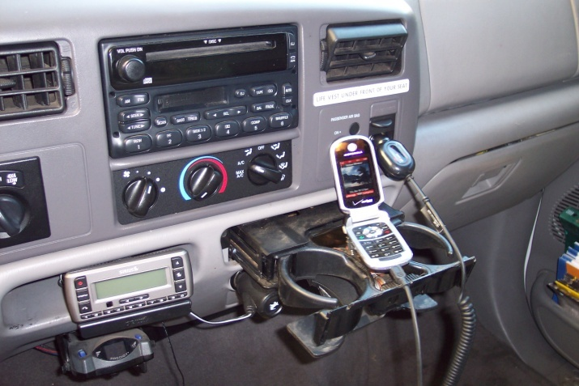
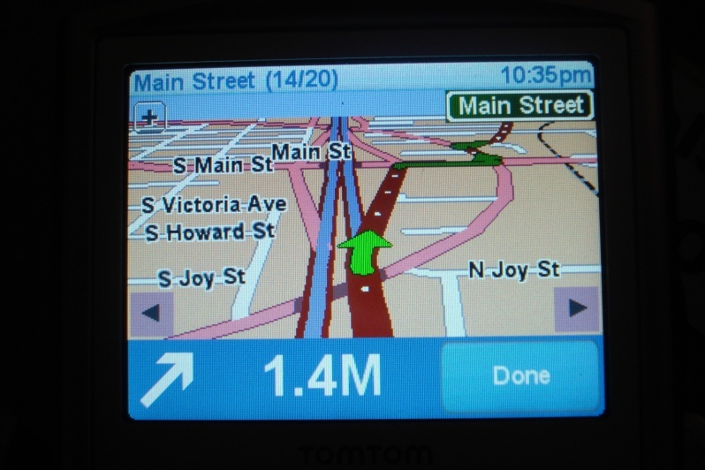
Beware of other battery sources
Cell phones
DVD players
iPods
Video Players
GPS devices

Slide 38


Stabilization Considerations
Stabilization is about stopping or preventing unwanted movement. If we use the example below, a pyramid with a narrow base is less stable than a pyramid with a wide base.
Wide footprint
will not tip easily
Narrow footprint tips easily

Slide 39
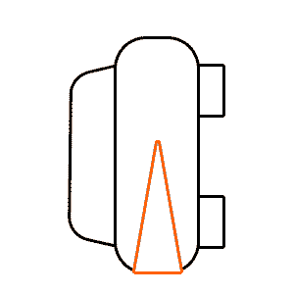
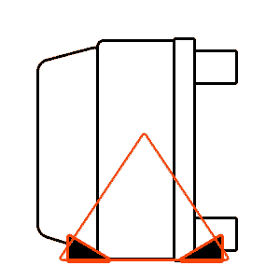
Stabilization Basics:
In the past, it was often easier to stabilize a vehicle not on its wheels. Surfaces of older cars were flat and made of steel. A couple of wedges provided enough surface area with the ground to keep the vehicle stable during extrication.
Newer vehicles often have rounded body styles and are made with thin steel or plastic dent resistant panels which can act like springs when they roll and bounce. Because they are more like beach balls than bricks they have a very narrow footprint when they land on their side or roofs, making them more unstable.
Old Car [Brick]
New Car (Beach Ball)

Slide 40
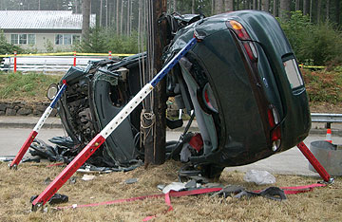
Vehicle vs Pole

Slide 41
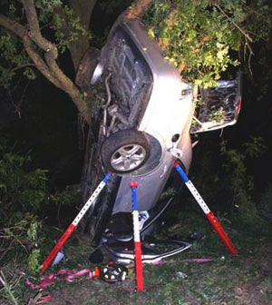

Slide 42
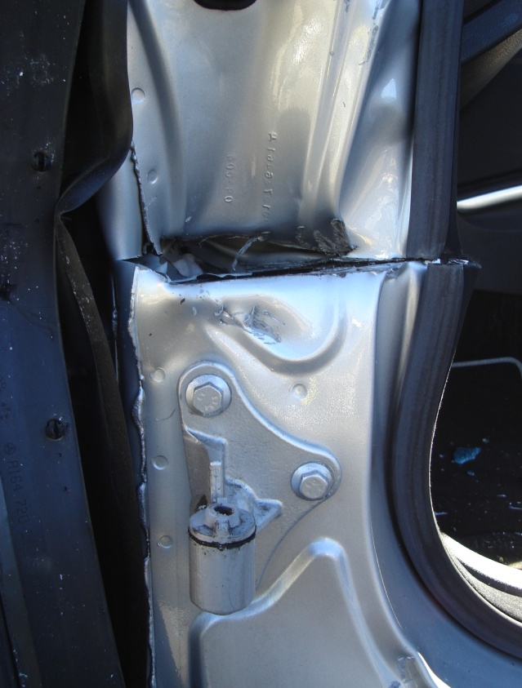
Dash Roll/Lift
The vehicle type WILL dictate how you roll or lift the dash away from the patient.
  Cut for dash roll
    -Above bottom hinge
    -As deep as possible
  *DO NOT cut at bottom of A-Post! Cutting into the rocker panel weakens vehicle and increase risk of cutting into fuel lines.

Slide 43
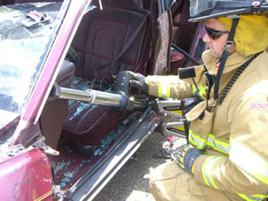
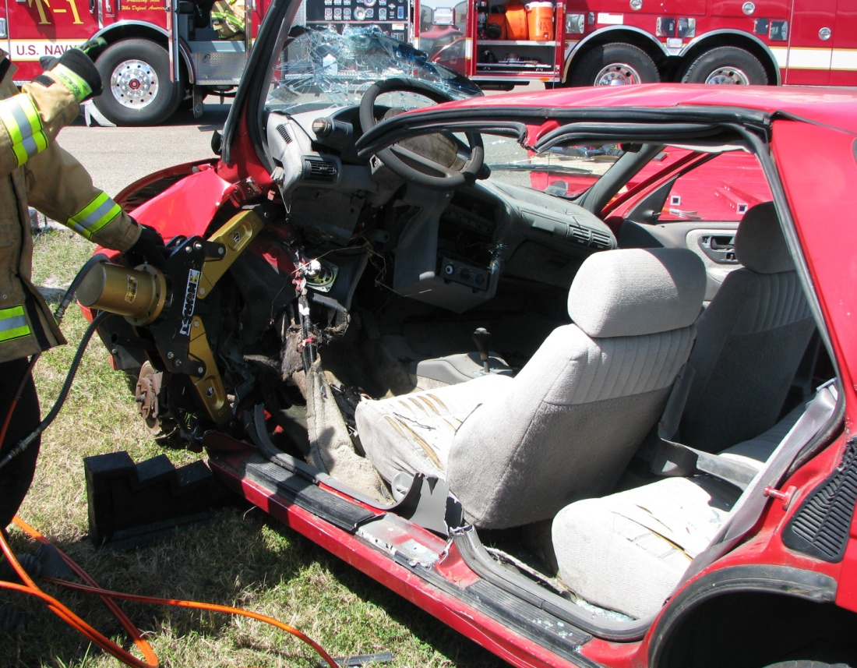
Dash Roll/Lift

