Slide 1
EMS Presentation
October 27, 2022

Slide 2
EMS Case #1/7

Slide 3
EMS Presentation
Date: September 9, 2022
Address: 106 Parachute Way
Team:
Cody Reece
Dean Perkins
Chase Spaid
Call: 37-year-old male not conscious. He has taken an unknown substance. Unknown if this was intentional or accidental. She is pumping his chest.

Slide 4
EMS assessment
Vitals: HR 110, BP 146/100, rr18, BG 120, temp 35.7, gcs 15
Exam: Normal
Assessment:
Dispatched to a 37-year-old male who had overdosed. A party on the scene had started CPR. She was his girlfriend who found him down. She pushed on his chest and then he came around. She stated he had a history of opioid abuse. He reported having some “blues” and drank 3 beers ”which must have been too much”. He he had used drugs for approximately 10 years. NKDA. He is on Suboxone. Patient refused transport.

Slide 5
ER evaluation
CBC and CMP normal
Head CT normal
Urine drug screen with methamphetamines or amphetamines
Discharged home with information and a prescription for Narcan.

Slide 6
Narcan
Naloxone can quickly restore normal breathing and save the life of a person who is overdosing on opioids.
In 2017, over 47,600 people died from an overdose on opioid drugs, including prescription pain relievers, heroin, and fentanyl.
A naloxone distribution program in Massachusetts reduced opioid overdose deaths, without increasing opioid use, by an estimated 11 percent in the nineteen communities that implemented the program.
A large-scale national study showed that opioid overdose deaths decreased by 14 percent in states after they enacted naloxone access laws.

Slide 7
Narcan
In 2015, the FDA approved the first naloxone nasal spray—NARCAN®−developed as a result of NIDA-funded research.
In 2019, the FDA approved the first generic naloxone nasal spray.
In 2021, the FDA approved a higher dose naloxone nasal spray—KLOXXADO®.
Increasing access to naloxone is a priority for the U.S. Department of Health and Human Services, and research funded by NIDA is developing strategies to identify people at risk and ensure they have access to naloxone in the event of an overdose.

Slide 8
Identifying At Risk Patients
A survey given to chronic pain patients receiving prescription opioids found that nearly 1 in 5 had experienced an overdose and more than half engaged in high-risk behaviors, including combining opioids with alcohol.
While only 3% of patients surveyed reported having a naloxone prescription or being trained to deliver naloxone
Nearly 40% had witnessed an overdose.
Another study found 68% of participants recruited from syringe service programs, detoxification, or opioid treatment programs had witnessed an overdose but only 17% had a prescription for naloxone.

Slide 9
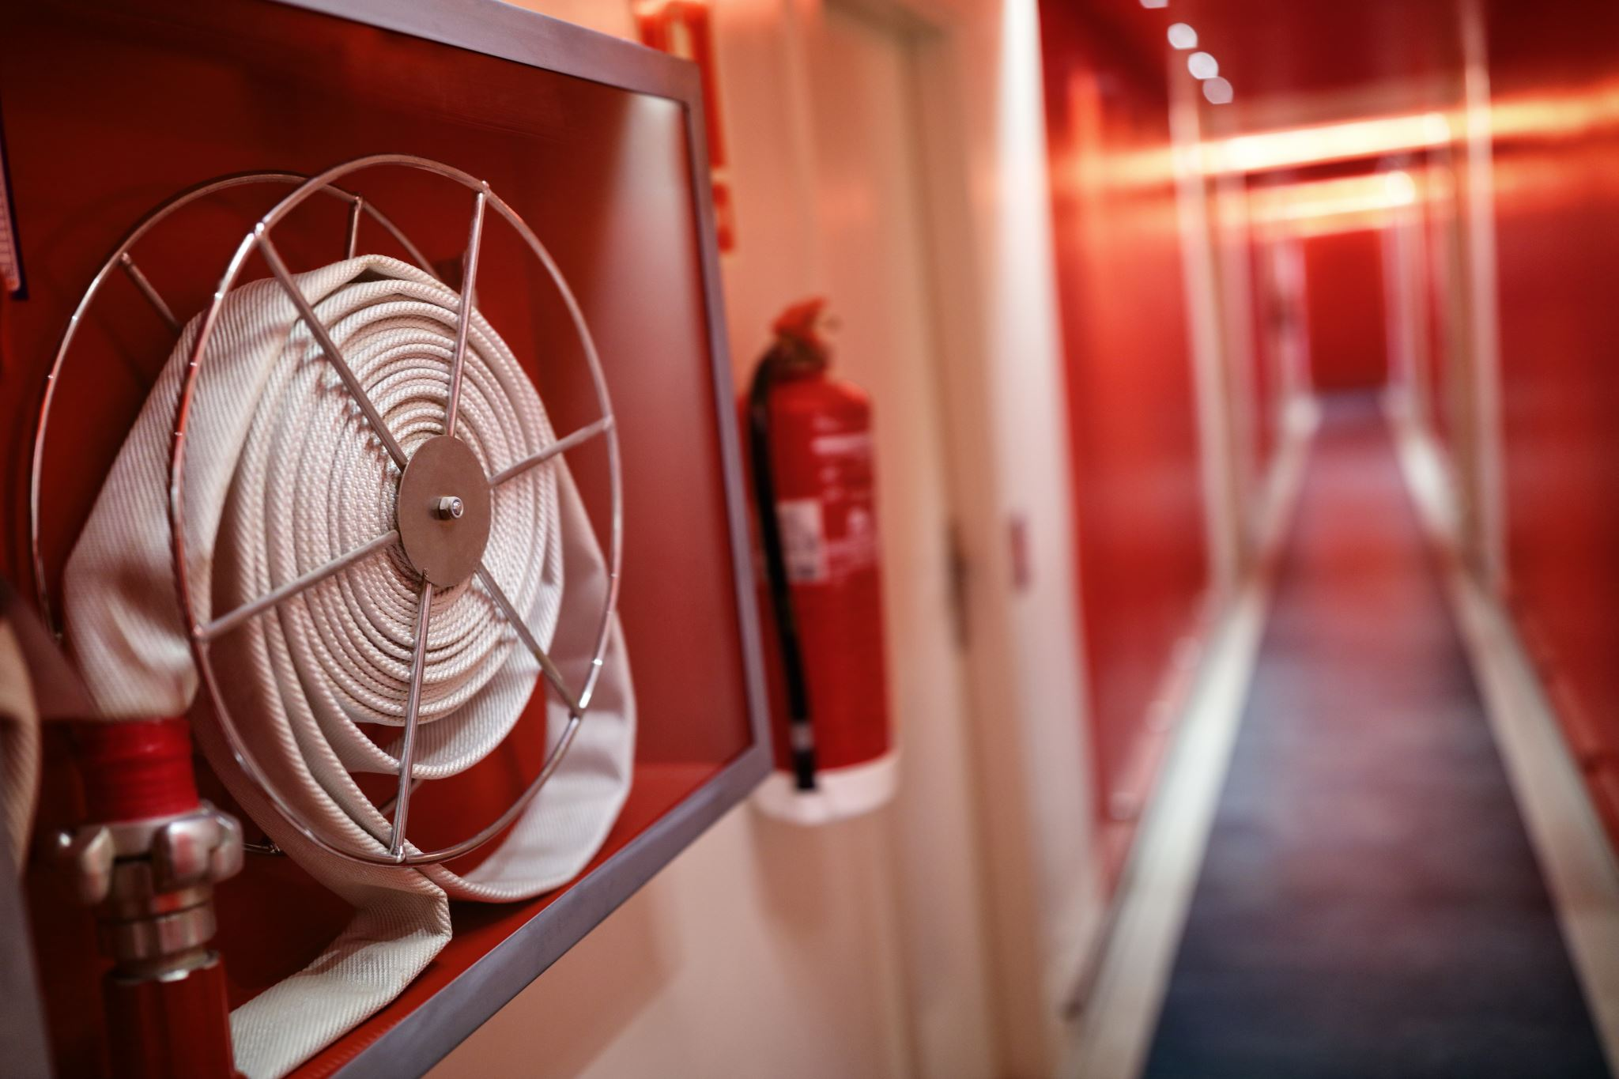
EMS Case #2/7

Slide 10
EMS presentation
Date: 10/8/2022
Address: 200 Cord 215
Team:
Cody Blair
Triston Quigley
Kevin Alvey
Call: Possible stroke vs TIA. Caller hung up. No other information.

Slide 11
EMS Assessment
Vitals: HR 50, Pulse ox 80%, RR 8 weak/agonal, BG 133, GCS 8
Exam: Heart normal, lungs with poor breath sounds, unresponsive, pupils sluggish
Interventions: IO placed left tibia, bagged, CPR, oral airway, oxygen at 15L NC, epinephrine
Rhythms: PEA
Summary: Male in his 40s laying on the ground at gas station on concrete floor. He appeared postictal from a seizure. He was unable to communicate with EMS. Only thing he said was that he could not breathe. On arrival , he found an obese adult male on the ground. He had poor skin color with central cyanosis noted on face and lips. He was also clammy and cool to the touch. He had sputum and light colored blood about the edge of his lips. He was awake and appeared to have an open airway and maintaining. He had fecal and urinary incontinence.

Slide 12
EMS Assessment
He was initially placed on high flow oxygen via a non-rebreather at 15L/min. He was rolled to the right. He appeared to become more aware of his surroundings as he was loaded onto the truck. He was not oriented. He then had another seizure. He was ventilated via bag mask ventilation. His oxygen dropped to 80%. Second IO was successful. Patient lost his pulse. Chest compressions were started and epinephrine. Care was transferred to the ER.

Slide 13
ER Evaluation
He was intubated on arrival to the ER with a 7.5cc ETT
He received four more rounds of epinephrine and four round of bicarbonate
Labs: WBC 14 with 7 bands, Potassium 3.3, glucose 390, lfts mildly elevated, troponin 0.33
No etiology for PEA found including a bedside ultrasound
Code called

Slide 14
Cardiac arrest and seizures
Among patients with epilepsy, sudden cardiac arrest (SCA) is recognized as a major cause of death.
The cause of SCA in patients with epilepsy is not well understood, but it is considered the most common cause of epilepsy-related death.
Among the general population, epilepsy is an independent risk factor for SCA compared with the general population.
Epilepsy confers a 3-fold higher risk of SCA and is more common in patients suffering from SCA in the setting of normal left ventricular systolic function

Slide 15
Seizures prior to arrest with EMS
From April 2012 to March 2020, 465 patients were studied in observational study.
The incidence of seizure-like activity at cardiac arrest onset was 12.7% (59/465) in all patients with nontraumatic, EMS-witnessed OHCA.
Seizure-like activity was common during shockable initial rhythm
In patients with “sudden” OHCA; and in patients who were younger, male, or had a presumed cardiac etiology.
Both seizure-like activity and agonal breathing recorded during EMS-witnessed OHCA were associated with favorable outcomes if rhythm was shockable.

Slide 16
EMS Case #3/7

Slide 17
EMS Presentation
Date: 10/15/2022
Address: 79 W 170
Team:
Forest Matis
Tom Henderson
Stephanie Voorhees
Marco Rojas-Vargas
Cody Reece
Call: Two vehicles in the ditch. Multiple injuries. High velocity. Male and female not responding appropriately after being trapped and pinned. Female is bleeding from her arm. Male is speaking. 4 teenagers are out and doing okay.

Slide 18
EMS Assessment
Additional information: MVC rollover at MM 79 EB 1-70. Two vehicles involved with possibly six victims. Juveniles noted to be walking and talking. Adults transported to GRH. Vehicle had body damage consistent with rolling once. All airbags deployed. Minimal passenger compartment intrusion. Toyota had all glass broken out and roof depressed about 8-10”. It also appeared to have rolled. Bed topper was sheared off with bed contents strewn widely, no airbag deployment. Adult parties extricated using hydraulic spreader/cutter to remove passenger door.
Vitals: HR 120, BP 154/107, RR22, Oxygen 97%, HCS 15
Interventions: IV and Fentanyl given
Additional Summary: Pt complained left arm and cervical pain. She is short of breath due to the pain. Abrasion noted to scalp. Pain left clavicle with pain in mid left chest. Pain noted in C7. Left upper arm pain noted. Transported C-collar/backboard/ETCO2.

Slide 19
ER Evaluation
Trauma Activation by criteria
Labs unremarkable except for mildly elevated liver tests
Imaging:
Right displaced posterior rib fractures 3-6
Transverse process fracture at T2
Right pneumothorax
Contusion right parotid
Distal humerus fracture

Slide 20
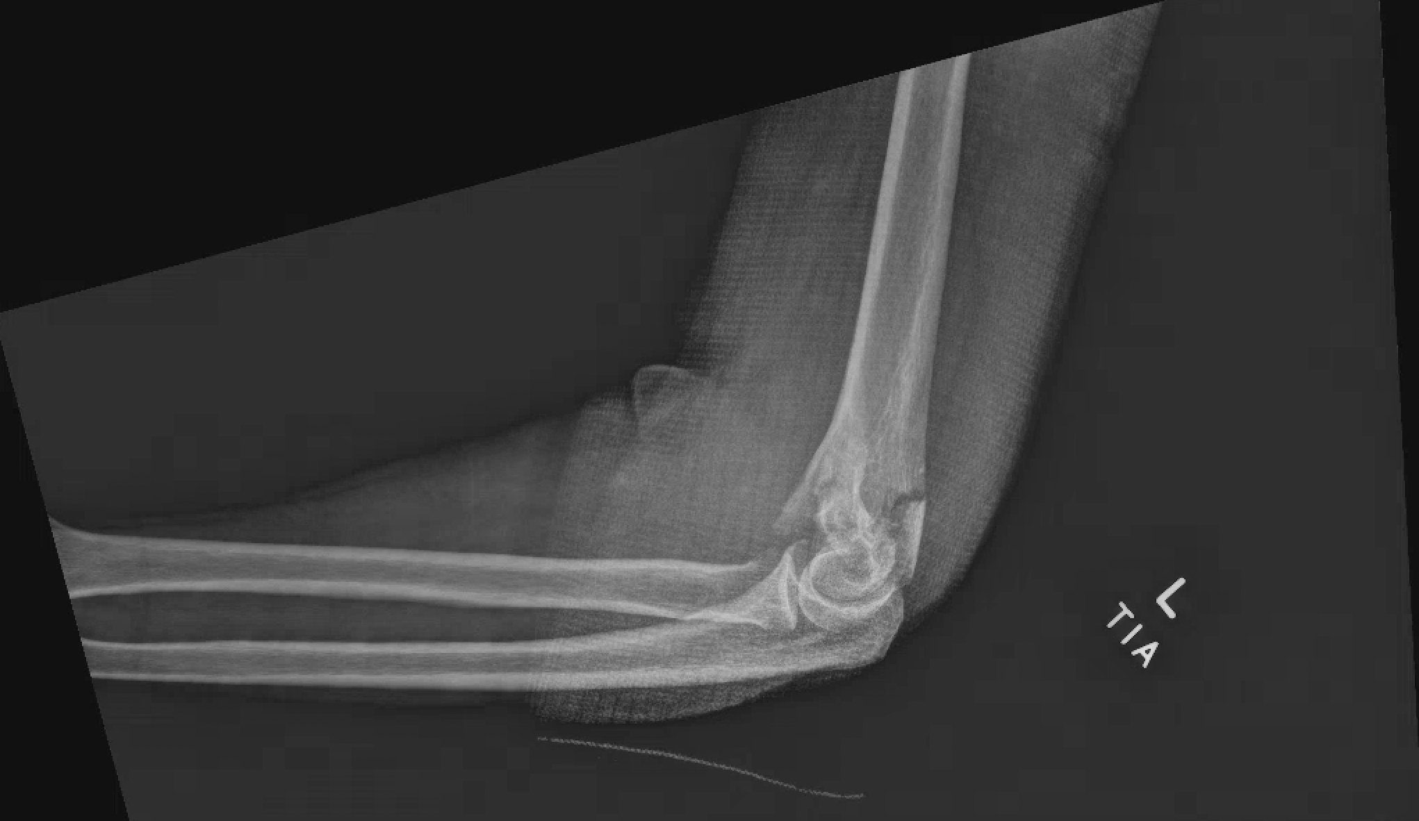
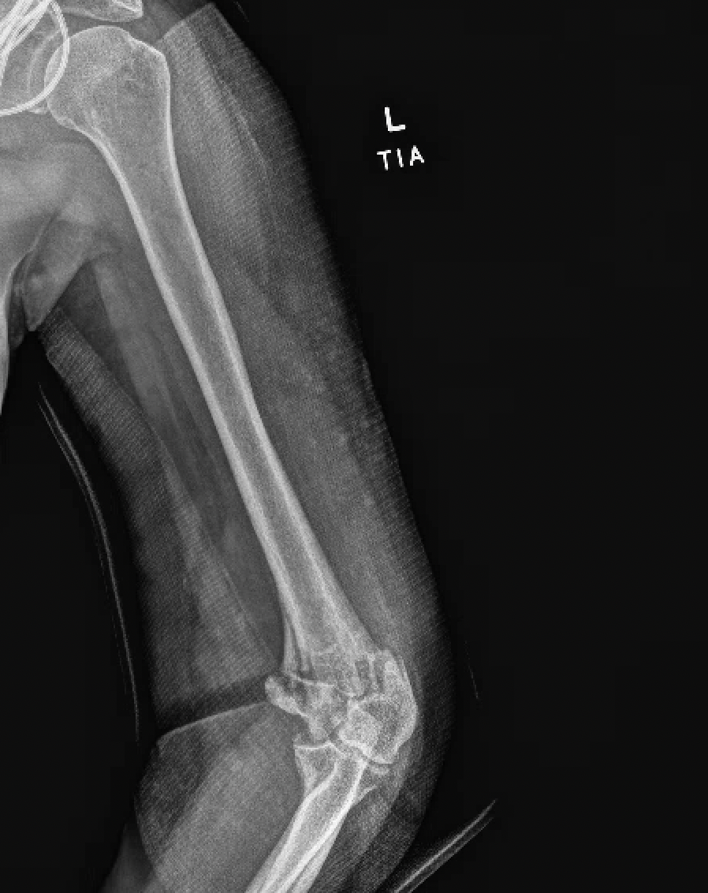

Slide 21
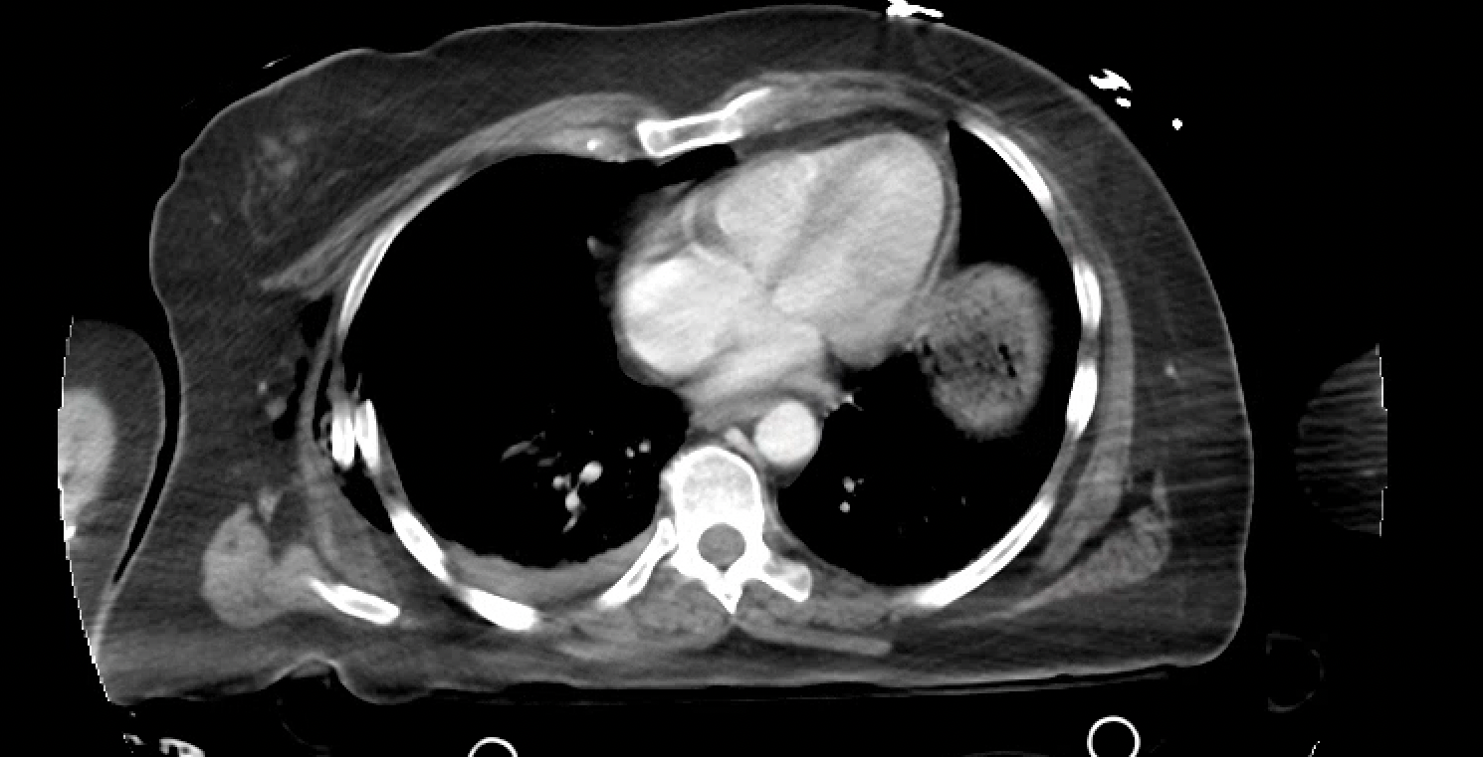

Slide 22
Chest Trauma
Chest trauma resulting from blunt or penetrating mechanisms is common, occurring in approximately 10% of patients admitted to hospital following injury.
The most common presentation of blunt chest trauma is rib fractures. This most commonly occurs at the posterior aspect of the rib, the weakest point. With the significant amount of force required to break ribs and the associated energy transfer, damage to underlying tissues occurs resulting in injuries such as pulmonary contusions. Optimal management of rib fractures can prevent complications and reduce associated mortality.
The severity of chest injury is proportional to the number of ribs fractured. The baseline mortality for patients admitted to hospital following rib fractures is 10%, but this increases with each additional rib fractured, approaching 40% if > 6 ribs are fractured

Slide 23
Chest Trauma
Thoracic paravertebral blocks (TPVB) enable the administration of local anesthetic to ventral and dorsal rami of ventral nerves within the paravertebral space. Analgesia can be achieved by intermittent injection, continuous infusion, or regular dosing through a catheter, which can produce a unilateral multilevel nerve blockade in contiguous dermatomes.
TPVB has proven to be as effective as TEA for pain management in patients with unilateral rib fractures and may contribute to improved survival.
Further, when compared with patients receiving intravenous patient-controlled analgesia (PCA), patients with TPVB reported lower pain scores; demonstrated superior respiratory parameters including FVC, FEV1/FVC, PaO2, and PaO2/FiO2; and experienced a lower incidence of nausea and vomiting.

Slide 24
Other Considerations
Pneumothorax
Tension pneumothorax
Hemothorax
Aortic injury
Cardiac injury

Slide 25
EMS Case #4/7

Slide 26
EMS Presentation
Date: October 14, 2022
Address: Exit 81 WB on ramp
Team:
Cody Reece
Triston Quigley
Call: Wife is having a seizure. Then report is that a 30-year-old is now unresponsive and not breathing. No AED available.

Slide 27
EMS Assessment
Vitals: HR 129, BP 105/57, RR 20, Oxygen 94%, BG 162, Temp 36.7, GCS 13
HR 133, BP 160/89, RR 14, Oxygen 99%, GCS 15
Exam: Exam normal but confused and not oriented to time
Interventions: IV, blood draw, NS bolus
Summary: 30-year-old female not conscious or breathing. Dispatch told that CPR was in progress followed by 30 seconds later that patient was awake. They had been traveling back to Parachute from Denver when his wife became stiff and would not respond. She was having trouble breathing which lasted 1 minute. PMH notable for no seizures. Positive for migraine HA. Only medication birth control. Seen the day before for N/V/D and possible food poisoning.

Slide 28
ER Evaluation
Exam: Unremarkable
Labs: WBC elevated at 19.9, potassium 3.4
Lactic acid elevated 3.1 and then improved to normal with hydration
Urine drug screen with cocaine
CT head normal
CT of abdomen with right hydronephrosis and urine retention with UA concerning for UTI
Cultures all negative

Slide 29
GI illnesses
1. Can be acquired by consuming contaminated food or beverages, contact with contaminated recreational water, infected animals or their environments, or infected people
2. The Division of Disease Control monitors and investigates GI illnesses that are spread through food, water, person-to-person contact and contact with infected animals.
3. Botulism, Campylobacteriosis, Cholera, Cryptosporidiosis, E coli, Giardiasis, Hepatitis A, Leptospirosis, Listeriosis, Norovirus, Salmonella, Shigella, Staph, Typhoid, Vibrio

Slide 30
Food Born GI illnesses
Many different disease-causing germs can contaminate foods, so there are many different foodborne infections (also called foodborne disease or food poisoning).
Researchers have identified more than 250 foodborne diseases.
Most of them are infections, caused by a variety of bacteria, viruses, and parasites.
Harmful toxins and chemicals also can contaminate foods and cause foodborne illness.
CDC estimates that each year 48 million people get sick from a foodborne illness, 128,000 are hospitalized, and 3,000 die.

Slide 31
GI Illnesses in the United States
The top five germs that cause illnesses from food eaten in the United States are:
Norovirus
Salmonella
Clostridium perfringens
Campylobacter
Staphylococcus aureus (Staph)

Slide 32
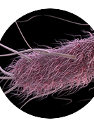
GI Illnesses in the United States
Some other germs don’t cause as many illnesses, but when they do, the illnesses are more likely to lead to hospitalization. Those germs include:
E. coli
Clostridium botulinum (botulism)
Listeria
Escherichia coli (E. coli)
Vibrio

Slide 33
Norovirus
The most common symptoms are:
Diarrhea, Vomiting, Nausea, Stomach pain
Outbreaks are common
The virus spreads very easily and quickly
Norovirus spreads:
From infected people to others
Through contaminated foods and surfaces
Outbreaks can happen anytime, but they occur most often from November to April
Recent outbreak in Grand Canyon

Slide 34
Salmonella
CDC estimates Salmonella bacteria cause about 1.35 million infections, 26,500 hospitalizations, and 420 deaths in the United States every year. Food is the source for most of these illnesses.
Most people who get ill from Salmonella have diarrhea, fever, and stomach cramps.
Symptoms usually begin 6 hours to 6 days after infection and last 4 to 7 days.
Most people recover without specific treatment and should not take antibiotics. Antibiotics are typically used only to treat people who have severe illness or who are at risk for it.
Some people’s illness may be so severe that they need to be hospitalized.

Slide 35
Clostridium perfringens
One of the most common causes of foodborne illness (food poisoning). CDC estimates these bacteria cause nearly 1 million illnesses in the United States every year.
C. perfringens can be found on raw meat and poultry, in the intestines of animals, and in the environment.
These bacteria make spores, which act like protective coatings that help the bacteria survive. Under certain conditions, such as when food is kept at an unsafe temperature (between 40°F–140°F), C. perfringens can grow and multiply. After someone swallows the bacteria, it can produce a toxin (poison) that causes diarrhea.
Common sources of C. perfringens infection include meat, poultry, gravies, and other foods cooked in large batches and held at an unsafe temperature. Outbreaks tend to happen in places that serve large groups of people, such as hospitals, school cafeterias, prisons, and nursing homes, and at events with catered food. C. perfringens outbreaks occur most often in November and December. Many of these outbreaks have been linked to foods commonly served during the holidays, such as turkey and roast beef.

Slide 36
Campylobacter
Campylobacter causes an estimated 1.5 million illnesses each year in the United States.
People can get Campylobacter infection by eating raw or undercooked poultry or eating something that touched it. They can also get it from eating other foods, including seafood, meat, and produce, by contact with animals, and by drinking untreated water.
Although people with Campylobacter infection usually recover on their own, some need antibiotic treatment.

Slide 37
Staph
People who carry Staph can contaminate food if they don’t wash their hands before touching it. If food is contaminated with Staph, the bacteria can multiply in the food and produce toxins that can make people ill. Staph bacteria are killed by cooking, but the toxins are not destroyed and will still be able to cause illness.
Foods that are not cooked after handling, such as sliced meats, puddings, pastries, and sandwiches, are especially risky if contaminated with Staph.
Food contaminated with Staph toxin may not smell bad or look spoiled.
Staph food poisoning is characterized by a sudden start of nausea, vomiting, and stomach cramps. Most people also have diarrhea.
Symptoms usually develop within 30 minutes to 8 hours after eating or drinking an item containing Staph toxin, and last no longer than 1 day. Severe illness is rare.

Slide 38
Botulism
Botulism is a rare but serious illness caused by a toxin that attacks the body’s nerves.
Symptoms of botulism usually start with weakness of the muscles that control the eyes, face, mouth, and throat. This weakness may spread to the neck, arms, torso, and legs. Botulism also can weaken the muscles involved in breathing, which can lead to difficulty breathing and even death.
Infant botulism can happen if the spores of the bacteria get into an infant’s intestines. The spores grow and produce the toxin which causes illness.
Foodborne botulism can happen by eating foods that have been contaminated with botulinum toxin. Common sources of foodborne botulism are homemade foods that have been improperly canned, preserved, or fermented. Though uncommon, store-bought foods also can be contaminated with botulinum toxin.

Slide 39
Listeria
Listeriosis is a serious infection usually caused by eating food contaminated with the bacterium Listeria monocytogenes.
An estimated 1,600 people get listeriosis each year, and about 260 die.
The infection is most likely to sicken pregnant women and their newborns, adults aged 65 or older, and people with weakened immune systems to invasive illness
People who are pregnant Symptoms typically include
Fever and Flu-like symptoms, such as muscle aches and fatigue
People who are not pregnant symptoms typically include
Fever, Flu-like symptoms, such as muscle aches and fatigue, Headache, seizures, confusion

Slide 40
Listeria
People who are pregnant
Symptoms in pregnant people are usually mild. Some pregnant people never have symptoms.
However, infection during pregnancy usually leads to miscarriage, stillbirth, premature delivery, or life-threatening infection of the newborn.
People who are not pregnant
Symptoms in non-pregnant people can be severe.
Almost 1 in 20 non-pregnant people with invasive listeriosis die.

Slide 41
Shigella
Most people with Shigella infection have diarrhea (sometimes bloody), fever, and stomach cramps.
Symptoms usually begin 1–2 days after infection and last 7 days.
Most people recover without needing antibiotics.
However, people with severe illness and those with underlying conditions that weaken the immune system should be given antibiotics.
Antibiotics can shorten the duration of illness (by about 2 days) and might help reduce the spread of Shigella to others.

Slide 42
Shigella Rare Risks
1. About 2% of people who are infected with certain types of Shigella, most commonly Shigella flexneri, will experience reactive arthritis after infection, which can cause joint pain, eye irritation, and painful urination. It usually lasts for 3 to 5 months, but occasionally it can last for years and lead to chronic arthritis.
2. Around 0.4% to 7.3% of people with Shigella infection (shigellosis) develop bloodstream infections. Bloodstream infections are most common among patients with weakened immune systems, such as those with HIV, diabetes, cancer, or severe malnutrition, and are more commonly seen in children. Shigellosis patients with bloodstream infections are at a higher risk of death compared to those with without bloodstream infections

Slide 43
Shigella Rare Risks
Seizures
Generalized seizures have been reported among young children with Shigella infection (shigellosis), but usually go away without treatment. Children with Shigella infection who experience seizures typically have a high fever, low blood sugar, or abnormal blood electrolytes (salts). However, healthcare professionals have not been able to definitively explain why these seizures occur

Slide 44
Hemolytic Uremia Syndrome
HUS is a serious disease that affects the kidneys and blood clotting system. It usually occurs after a person has had a diarrheal illness caused by a toxin-producing bacterium. Most cases of HUS occur as a rare complication of infection with the bacterium E. coli O157:H7.
Anyone can get HUS. HUS is a rare disease but is more common in children than adults, especially children less than five years of age. HUS is the leading cause of acute kidney failure in children. About 200-300 cases of HUS are reported in the United States each year.
HUS can be mild or severe. Early symptoms of HUS include decreased urine output, diarrhea, and feeling slow and tired (lethargy). Low red blood cell count (anemia), low platelet count, and decreased kidney function are signs that might be detected by laboratory testing. Fever and neurologic changes (e.g., drowsiness, unconsciousness, and seizures) are also common among patients

Slide 45
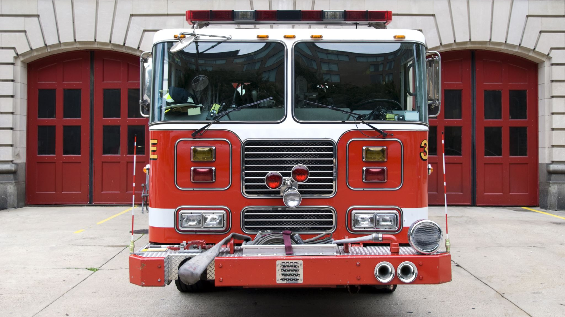
EMS Case #5/7

Slide 46
EMS Presentation
Date: October 9, 2022
Address: 58 Holly Way
Team:
Cody Reece
Kevin Alvey
Call: Patient advised his daughter is having a female. She is 5 yo with no history of epilepsy. This was a generalized grand mal seizure. No diabetes.

Slide 47
EMS Assessment
Vitals: HR 125, RR22, Oxygen 96%, Temp 36, GCS 15
Exam: Normal
Summary: Father reports she had come into his bedroom and climbed in bed and gone to sleep. Shortly after, he noted that she was convulsing so he woke his wife and called 911. He noted the episode lasted about 15 seconds. It stopped and then another occurred. She has no history of seizures. She was stiff and shaky and then back to normal. No known allergies or medications. She had been sick with a cold x 2 days and felt “warm” when she crawled into bed. Parents opted to treat with antipyretics and refused transport.

Slide 48
ER Evaluation
No follow up

Slide 49
Febrile Seizures
Febrile seizures are seizures or convulsions that occur in young children and are triggered by fever. The fever may accompany common childhood illnesses such as a cold, the flu, or an ear infection. In some cases, a child may not have a fever at the time of the seizure but will develop one a few hours later.
If a child has a fever, most parents will use fever-lowering drugs such as acetaminophen or ibuprofen to make the child more comfortable. However, studies show this does not reduce the risk of having another febrile seizure.
Most febrile seizures last only a few minutes and are accompanied by a fever above 101°F (38.3°C). Young children between the ages of about 6 months and 5 years old are the most likely to experience febrile seizures. Children are at the greatest risk of having a febrile seizure at age 2.

Slide 50
Febrile Seizures
Febrile seizures are the most common type of convulsions in infants and young children and occur in 2 to 5 percent of American children before age 5. Approximately 40 percent of children who experience one febrile seizure will have a recurrence.
Children at highest risk for recurrence are those who have:
Young age. Children who have their first febrile seizure when they are younger than 18 months are at an increased risk of having another one.
Family history. Children whose family members had febrile seizures are more likely to have more than one seizure.
First sign of illness. Children who have febrile seizures before exhibiting other symptoms of an illness, are at greater risk of having multiple seizures.
Low temperature. Children are more likely to have another febrile seizure if the first one was accompanied by a relatively low temperature.

Slide 51
Simple or Complex???
Febrile seizures are considered “simple” if they meet all of the following criteria:
Generalized full body convulsions
Last less than 15 minutes
No more than one in a 24-hour period
Febrile seizures are considered “complex or complicated” if any of the following features are present:
Start focally with one body part moving independently of others
Last more than 15 minutes
Occur more than once in a 24-hour period

Slide 52
Rhinovirus/enterovirus
The CDC has issued an alert for healthcare providers over the rise of respiratory illnesses in children.

Slide 53
Acute Flaccid Myelitis
Acute flaccid myelitis (AFM) is a rare but serious condition that affects the spinal cord. It can cause sudden weakness in the arms or legs, loss of muscle tone, and loss of reflexes. The condition mainly affects young children.
Most children have a mild respiratory illness or fever caused by a viral infection about one to four weeks before developing symptoms of acute flaccid myelitis.
Outbreaks tend to occur between August and November.
Most common cause is Enterovirus
Young children are particularly susceptible

Slide 54
AFM Symptoms
The most common signs and symptoms of acute flaccid myelitis include:
Sudden arm or leg weakness
Sudden loss of muscle tone
Sudden loss of reflexes
Other possible signs and symptoms include:
Difficulty moving the eyes or drooping eyelids
Facial droop or weakness
Difficulty with swallowing or slurred speech
Pain in the arms, legs, neck or back
Uncommon symptoms might include:
Numbness or tingling
Inability to pass urine

Slide 55
EMS Case #6/7

Slide 56
EMS Presentation
Date: 10/15/2022
Address: Mesa Vista Assisted Living #6
Team:
Tyler Sepsey
Cody Reece
Tom Henderson
Call: Resident has been declining and now cannot stand without falling. No alert. Cannot stay awake long enough to eat. She is a 56-year-old female. Not acting right.

Slide 57
EMS Assessment
Extensive Medication List: Prozac, Advair, Combivent, Januvia, Gabapentin, Lactaid, Levemir, Lisinopril, Loperamide, Omeprazole, Oxycodone, Pradaxa, Pramipexole, Phenergan, Sucralfate, Tramadol, Tylenol, Ventolin
Vitals: HR 80, RR 16, Oxygen 93%, BG 70, Temp 36, GCS 14, BP 119/76
Exam: Normal and oriented with poor gait.
Summary: 56-year-old female with complaint of altered mental status. Staff found the patient lying face down on her bed. She states that she feels fine other than being tired and exhausted. She reports she felt her sugar was low. She could not remember what she ate for lunch. She reports she had fallen a couple of times. She was alert and able to answer questions but would fall asleep. BG improved 70 to 110 with oral glucose. Unable to ambulate.

Slide 58
ER Evaluation
Exam and history same
Labs: Low white blood cells at 3.7 and low platelets at 121
Potassium 3.4, Glucose 58
Lactic normal, CRP elevated
Urine: multiple markers for UTI
Admitted for UTI and cellulitis as well as hypoglycemia
Cultures grew Klebsiella pneumonia

Slide 59
Hypoglycemia and Acute Illness
The Action to Control Cardiovascular Risk in Diabetes (ACCORD) study found that, compared to patients with conventional glucose control, patients under tight glycemic control had an excess mortality rate, particularly in those with multiple risk factors or known coronary artery disease.
Recent studies have shown that hypoglycemia is associated with adverse outcomes in many acute illnesses.
Of the 4,946 patients studied, 1,109 (22.4%) had hypoglycemia; the hospital mortality rate of those patients was 36.6%, whereas it was 19.7% in patients without hypoglycemia (P < 0.001). Additionally, mortality increased significantly according to the severity of hypoglycemia (P < 0.001).

Slide 60
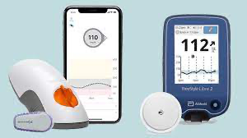
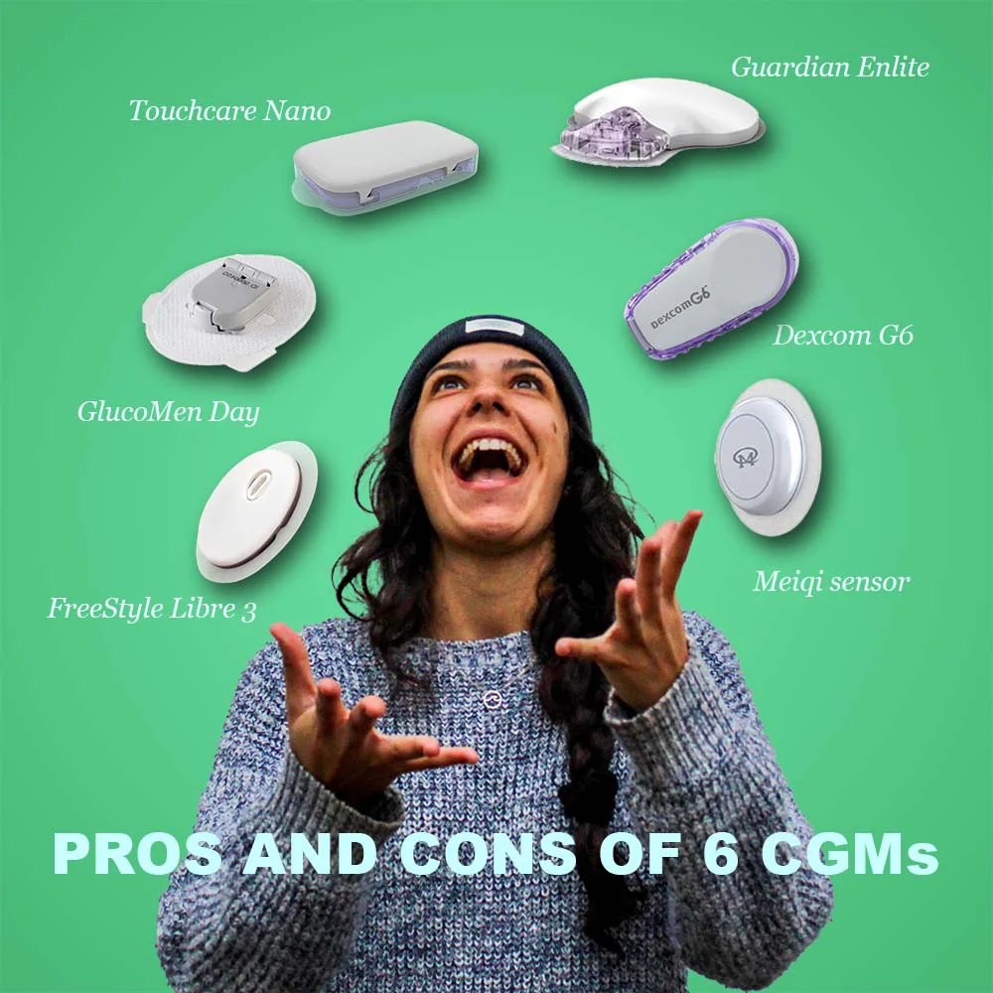
Continuous Glucose Monitors

Slide 61
EMS Case #7/7

Slide 62
EMS Presentation
Date: 10/15/2022
Address: 35 Larkspur pl
Team:
Forest Matis
Tom Henderson
Stephanie Voorhees
Call: A 64-year-old male with chest pain. He has a history of chest pain and previous myocardial infarction. He has had 2 baby aspirin.

Slide 63
EMS Assessment
Extensive medications: Alendronate, amitriptyline, aspirin, buprenorphine, carvedilol, fluconazole, insulin, furosemide, gabapentin, metformin, ondansetron, pantoprazole, simvastatin, tamsulosin
Vitals: HR 85, BP 160/92, RR 16, Oxygen 94%, BG 147, AF, GCS 15
Interventions: IV placed, Oxygen 4L NC, Nitroglycerin
Summary: He reports he has not been feeling himself for the last 24 hours. He has had a decrease in energy and now sudden onset of chest pain. Chest pain is short and worsens with movement. It feels better if he sits up. He has a history of cardiac disease, MI in 2013, GI bleed in April of 2022. He has had four baby aspirin. Nitroglycerin helped the pain. 12 lead LBBB.

Slide 64
ER Evaluation
Admitted due to high risk chest pain
ECHO showed severe cardiomyopathy with EF 25% and severe diastolic failure
No concerns for new MI
Cardiology consulted and recommended outpatient evaluation for AICD
Incidentally found with pancytopenia so BM done and final path pending
Also noted with cirrhosis, portal hypertension, and splenomegaly

Slide 65
AICDs
Sudden cardiac arrest (SCA) is among the leading causes of death worldwide and is responsible for 250,000-450,000 deaths per year in the United States alone.
SCA has a higher incidence in those with reduced LVEF in the months after acute myocardial infarction (MI) and/or following revascularization.
At present, ICD implantation for primary prophylaxis is usually deferred for 3 months following revascularization and then used only if ejection fraction <35%.
Ischemic cardiomyopathy trials demonstrated a statistically significant 28% reduction in all-cause mortality reduction with ICD placement
ICDs reduce all-cause mortality by 23% in patients with NICM

Slide 66
Pacemakers and ICDs and CPR
Most pacemakers and ICDs (implantable cardioverter defibrillators) are implanted in the upper left side of the chest.
During CPR, chest compressions are done in the center of the chest and should not affect a pacemaker or ICD that has been in place for a while. If your pacemaker has been inserted recently, there’s a small chance that the leads may be moved by vigorous chest compressions.
If a defibrillator is available, it should be used immediately. It analyses the heart rhythm through externally placed pads, and if it detects that the heart has been restored to a normal rhythm by an ICD, it won’t deliver a shock. The ICDs won’t be damaged by the defibrillator.
The AHA recommends that the responder allow 30 to 60 seconds for the implanted device to complete the therapy cycle before administering external defibrillation

